Slide 1
Accelerating Digital Transformation with Application Modernization at a Global Scale

Slide 2

The world is changing
Notes:
Let’s start by talking about how the world is changing
We all aspire to create disruption that
constructs new realities for customers and
builds a distinct advantage for our organizations.
In order to make that leap, we have to look across trends and decide:
which variables and trends we need to care about
which ones will prevail
which ones we invest in

Slide 3
Demands of modern applications
Create great customer experiences
across multiple devices
anywhere in the world
Data needs to
support the application
needs globally
Provide intelligent
app experience
Notes:
Create great customer experiences
Reach customers on the screen of their choice
Personalize app experiences at scale
Deliver secure app experiences
Make sure the Data support the application needs globally
Support requirements of global apps without effecting speed performance and consistency
Scale up and down as needed
Whilst still protecting the needs Data protection with leading security innovations built-in
Ability to build intelligence into their app and take advantage of the latest innovations in AI to create new differentiated human-like experience for users
Microsoft Azure enables developers to easily build and deliver intelligent apps faster by offering the most productive and familiar tools to integrate data, choice of stack for any scenario, and AI that is already built in.

Slide 4
Today’s customers have high expectations
65% get frustrated with inconsistent device experiences
79% won’t return to a slow website
38% won't call again if they have to repeat themselves
Notes:
Just like how customer experience have become critical to the success , your customers expectations have also increase
Your customers have really high expectations.
1) They want to know them and be aware of their context and needs, make it easy to engage with your business whether they are looking to learn more about a product or service or buying from you. And do so in a way that is consistent where they are experiencing your business whether they are home at work on the go. And they want an experience that is fast - milliseconds not minutes is the new measure of wait times.
and fast
References:
https://www.glassboxdigital.com/
2) Accenture Global Consumer Pulse 2013
3) https://blog.kissmetrics.com/speed-is-a-killer/
4) 29% said they are were less likely to buy products if they receive irrelevant marketing (1)
Janrain and Blue Research (http://janrain.com/about/newsroom/press-releases/national-study-shows-consumers-abandon-brands-online-out-of-frustration-with-mistargeting/)
http://www.huffingtonpost.com/entry/dont-let-irrelevant-messaging-cause-your-customers_us_584eddf9e4b0151082221db6

Slide 5

“More than any other factor, customer experiences determine whether companies thrive and profit, or struggle and fade.”
—Forrester Research
Notes:
More than any other factor, customer experiences determine whether companies thrive and profit, or struggle and fade.
For many companies this means status quo is not strategy.
---------------------------
Reference
http://blogs.forrester.com/harley_manning/12-09-14-when_it_comes_to_total_returns_customer_experience_leaders_spank_customer_experience_laggards
Over the course of the five-year period, the customer experience leaders spanked the laggards in stock performance. The leader portfolio had a cumulative total return of +22.5%, compared with a -46.3% decline for the laggard portfolio.

Slide 6
Optimized for today’s data-driven priorities
Today’s requirements
Global reach
Security
Low latency
Data variety
Infinite ingestion
Predictive analytics
Key scenarios
Transactional
Real-time experiences
Big Data processing
Artificial intelligence

Slide 7
Transform your apps with data + AI
Real-time experiences
Engage customers with planet-scale apps that deliver real-time experiences anywhere in the world
Transactional
Drive business requirements with Azure backed by SQL-based and Azure Cosmos DB innovation
Big Data processing
Gain insights with high-processing workloads & analytics
Artificial intelligence (AI)
Transform apps by increasing customer engagement through chatbots and human-like intelligence
Modernize on-premises applications to take advantage of latest innovation
Grow your business by transforming to software-as-a-service; accelerate innovations to customers
On-prem apps
SaaS apps

Slide 8
Real-time experiences at a global scale
Meet and exceed your business requirements:
Performance around the world with a serverless architecture
Deliver greater customer choice and real-time notifications
Intelligent predictions based on complex data
Improved customer awareness through event-driven scenarios
Engage all your customers with planet-scale apps that deliver real-time, personalized experiences
Ingest massive volumes of data
Run predictive models in real-time
Serve up unique information or recommendations
Notes:
Compelling digital experiences for every user
Modern data platform for intelligent applications
A cloud built for your stack and your app
Open and extensible tools and services for developers
The Microsoft Application Innovation Solution helps businesses engage customers in new and exciting ways and stand out from the crowd
Deliver personalized, high-quality application experiences that incorporate data and intelligence, implement efficient processes and get the flexible tools you need to work across teams, continuously building, testing, and releasing new features and applications
The Microsoft Application Innovation Solution makes it easy for developers to drive business innovation with next-generation applications
With the Microsoft Application Innovation Solution, organizations of any size ensure their development resources, talent, and systems are prepared to meet current needs and exceed future demand

Slide 9




Real-time experiences on Azure
Benefits of Azure for real-time experiences at global scale
Define accurate, low-latency apps with tunable settings that balance consistency and performance
Enable turnkey global distribution with scaling based on global demand, enabling an always on system
Serverless, event-driven architecture enables triggered experiences based on change data feed
Azure Cosmos DB Spark API enables Spark analytics over operational data
Run ML models in Spark for
real-time recommendations
ContosoAir App
Azure Notification Hub
Spark Azure Data Bricks
Power BI
Region 1
Region 2
Region 3
Azure Cosmos DB
Region 4
App Service
Azure Functions
Region 6
Region 5
Strong
Bounded-stateless
Session
Consistent prefix
Eventual

Slide 10


Scenario
Online retail looking to always present the best market price available across 31 million products
Scalable and integrated cloud + data environment to support innovative pricing strategies
Solution
Built from zero to full-fledged commerce marketplace in 12 months
Leveraging Azure Cosmos DB, Jet.com can scale across multiple regions processing 100 trillion transactions per day
With HDInsight and SQL Data Warehouse, they can runs thousands of analytical queries per day over tens of billions of records—about 20TB of data to monitor price history and market dynamics—adjusting prices real-time and offering real-time recommendations
Notes:
“with Azure SQL Data Warehouse, we use PolyBase to ingest data from HDInsight then run thousands of analytical queries per day over tens of billions of records—about 20TB of data. This enables us to monitor price history and market dynamics to adjust pricing and ensure we’re offering our customers the best price”

Slide 11
Innovate on your transactional apps
Meet and exceed your business requirements:
͏Instantaneous application response times​
͏Business continuity and productivity​
͏Protection for your customer’s data and your brand​
͏Built-in intelligence that drives user productivity​
͏New insights from complex data relationships​
͏Powerful analytics and insights from Big Data​
͏Ability to accelerate innovations to your users
Modernize relational apps backed by SQL-based innovation:
Meet today’s high performance and scale needs
Drive the highest data security
Leverage Azure Cosmos DB to innovate over your apps at a global scale
Notes:
Compelling digital experiences for every user
Modern data platform for intelligent applications
A cloud built for your stack and your app
Open and extensible tools and services for developers
The Microsoft Application Innovation Solution helps businesses engage customers in new and exciting ways and stand out from the crowd
Deliver personalized, high-quality application experiences that incorporate data and intelligence, implement efficient processes and get the flexible tools you need to work across teams, continuously building, testing, and releasing new features and applications
The Microsoft Application Innovation Solution makes it easy for developers to drive business innovation with next-generation applications
With the Microsoft Application Innovation Solution, organizations of any size ensure their development resources, talent, and systems are prepared to meet current needs and exceed future demand

Slide 12





ASOS is winning with Azure
Scenario
ASOS needed an app that could scale to meet seasonal demand and use customer data to better serve their needs. ASOS migrated their SQL-based commerce platform to Azure
Solution
Reimagined to a microservices architecture. Azure SQL Database underpins many of their key microservices for retail—helping enable 167 million requests in 24 hours on Black Friday while Geo-replication ensures data is protected and available
Expanded commerce platform to include real-time personalization using Azure Cosmos DB—storing and retrieving precalculated user profiles and product machine learning models to generate real-time recommendations for 15 million customers
Real-time analytics enabled with cold path using Azure Event Hub, Azure Data Lake Store, and HDInsight + Spark combined with a hot path using Service Fabric and Azure Cosmos DB with Data Factory to schedule jobs for refreshing persisted models
Notes:
Transactional
Real-time experiences
Big Data processing

Slide 13
Big Data processing
Meet and exceed your business requirements:
Ingest and process massive volumes of data
Enable business insights from unstructured data
Apply real-time analytics for instant updates
Infuse AI into apps to actively engage with customers
Improve performance and gain insights by running applications with data-intense, high-processing workloads and analytics for global applications:
Bottomless compute and data storage for storing all data
Real-time processing of data for real-time insights
Combine relational and Big Data
Notes:
Compelling digital experiences for every user
Modern data platform for intelligent applications
A cloud built for your stack and your app
Open and extensible tools and services for developers
The Microsoft Application Innovation Solution helps businesses engage customers in new and exciting ways and stand out from the crowd
Deliver personalized, high-quality application experiences that incorporate data and intelligence, implement efficient processes and get the flexible tools you need to work across teams, continuously building, testing, and releasing new features and applications
The Microsoft Application Innovation Solution makes it easy for developers to drive business innovation with next-generation applications
With the Microsoft Application Innovation Solution, organizations of any size ensure their development resources, talent, and systems are prepared to meet current needs and exceed future demand

Slide 14




Big Data processing on Azure
Azure benefits for Big Data processing:
Limitless scale and data ingestion
Store any data in its native format; optimized for business requirements
Enterprise-grade access control, encryption at rest across all data stores and processing engines
Open and extensible tools and services for developers, data engineers, and data scientists
Support batch or streaming analytics for greater business insights
Drive insights back into the application experience
External data
Market data
Azure Data Bricks and Spark
Social media
Azure Cosmos DB
Unstructured app data
Comments, ratings
10 01
Business apps
Clickstream logs, telemetry
Azure Storage Blobs
IoT
LOB & POS apps
PolyBase
Structured app data
Azure SQL DW
Power BI
Retail store
Service layer 1
Website & mobile apps
Service layer 2
Web store
SQL
Service layer 1
Service layer 3
Mobile store
Azure SQL DB
Service layer 1

Slide 15
Artificial intelligence
Meet and exceed your business requirements:
Extend and scale customer care resources
Interpret and respond to customer engagement across text, image, voice
Apply real-time analytics for sentiment analysis
Transfer to live agents on-the-fly
Transform global apps by increasing customer engagement through chatbots and human-like intelligence
Notes:
Compelling digital experiences for every user
Modern data platform for intelligent applications
A cloud built for your stack and your app
Open and extensible tools and services for developers
The Microsoft Application Innovation Solution helps businesses engage customers in new and exciting ways and stand out from the crowd
Deliver personalized, high-quality application experiences that incorporate data and intelligence, implement efficient processes and get the flexible tools you need to work across teams, continuously building, testing, and releasing new features and applications
The Microsoft Application Innovation Solution makes it easy for developers to drive business innovation with next-generation applications
With the Microsoft Application Innovation Solution, organizations of any size ensure their development resources, talent, and systems are prepared to meet current needs and exceed future demand

Slide 16
AI-driven experiences on Azure
Azure benefits for AI:
Augment customer care/service experiences with AI
Engage with customers in a natural way within your apps
Interpret meaning of data including text, voice, and images
Serve up knowledgebase data to feed agent-based interactions
Adapt your experience to customers habits, preferences, or past activities
Evaluate and understand your customer feedback at scale
Identify complex patterns or behaviors to make better decisions
Sentiment analysis
Azure Data Bricks and Spark
Cognitive Services
Azure Cosmos DB
Vision
Speech
Text
Knowledge
Language
Business apps
Azure Bot Service
10 01
LOB & POS apps
Azure Storage Blobs
Customer care knowledge
Website & mobile apps
SQL
Azure Search
Azure SQL DB

Slide 17
Modern apps face new challenges
Managing and syncing data distributed around the globe
Delivering highly-responsive, real-time personalization
Processing and analyzing large, complex data
Scaling both throughput and storage based on global demand
Offering low-latency to global users
Modernizing existing apps and data
Notes:
*watch Rimma’s video for context and talking points <<need link>> Azure Cosmos DB vision is to be the database for all planet-scale applications and scenarios.
The picture I want you to take away is this.
Build planet-scale databases without worry.
Model the data the way your application needs it to be.
Use the API, tools and framework that you are familiar with.

Slide 18
Azure Cosmos DB
A fully-managed globally distributed database service built to guarantee
Extremely low latency and massive scale for global apps

Slide 19



Azure Cosmos DB
A globally distributed, massively scalable, multi-model database service
Table API
SQL
Key-value
Column-family
Document
Graph
Guaranteed low latency at the 99th percentile
Elastic scale out of storage & throughput
Five well-defined consistency models
Turnkey global distribution
Comprehensive SLAs

Slide 20
Turnkey global distribution
Put your data where your users are in minutes
Automatically replicate all your data around the world, and across more regions than Amazon and Google combined.
Available in all Azure regions
Manual and automatic failover
Automatic & synchronous multi-region replication
Notes:
Elastic Scale out -> Tunable Consistency
Small storage – large throughput (e.g. notification broadcast/poll)
Large storage – small throughput (e.g. classic data/log store)

Slide 21
Elastic scale out of storage and throughput
Scales as your apps’ needs change
Independently and elastically scale storage and throughput across regions—even during unpredictable traffic bursts—with a database that adapts to your app’s needs
Elastically scale throughput from 10 to 100s of millions of requests/sec across multiple regions
Support for requests/sec for different workloads
Pay only for the throughput and storage you need
Notes:
Elastic Scale out -> Tunable Consistency
Small storage – large throughput (e.g. notification broadcast/poll)
Large storage – small throughput (e.g. classic data/log store)

Slide 22
Guaranteed low latency
Provide users around the world with fast access to data
Serve <10 ms read and <15 ms write requests at the 99th percentile from the region nearest to users, while delivering data globally
Notes:
Single digit latency -> SLA

Slide 23
Five well-defined consistency models
Choose the best consistency model for your app
Offers five consistency models
Provides control over performance-consistency tradeoffs, backed by comprehensive SLAs
An intuitive programming model offering low latency and high availability for your planet-scale app
Strong
Bounded-stateless
Session
Consistent prefix
Eventual
Notes:
Tunable Consistency -> Single digit latency
Bounded Staleness - Consistent Prefix. Reads lag behind writes by k prefixes or t interval
Session - Consistent Prefix. Monotonic reads, monotonic writes, read-your-writes, write-follows-reads
Consistent Prefix - Updates returned are some prefix of all the updates, with no gaps

Slide 24
Multiple data models and APIs
USE THE MODEL THAT FITS YOUR REQUIREMENTS, AND THE APIS, TOOLS, AND FRAMEWORKS YOU PREFER
Cosmos DB offers a multitude of APIs to access and query data including, SQL, various popular OSS APIs, and native support for NoSQL workloads.
Use key-value, tabular, graph, and document data
Data is automatically indexed, with no schema or secondary indexes required
Blazing fast queries with no lag
MongoDB
Table API
SQL
Column-family
Document
Key-value
Graph
Notes:
Multi – Model -> Elastic Scale out
No need to convert you data to meet any particular model

Slide 25
Comprehensive SLAs
RUN YOUR APP ON WORLD-CLASS INFRASTRUCTURE
Azure Cosmos DB is the only service with financially-backed SLAs for millisecond latency at the 99th percentile, 99.999% HA and guaranteed throughput and consistency
Latency
HA
Throughput
Consistency
<10 ms
99.999%
Guaranteed
Guaranteed
99th percentile
Notes:
HA 99.999% for multi-region read; 99.99% for single region deployments

Slide 26
Handle any data with no schema or indexing required
Azure Cosmos DB’s schema-less service automatically indexes all your data, regardless of the data model, to delivery blazing fast queries.
Automatic index management
Synchronous auto-indexing
No schemas or secondary indices needed
Works across every data model
GEEK
Item | Color | Microwave safe | Liquid capacity | CPU | Memory | Storage
Geek mug | Graphite | Yes | 16ox | ??? | ??? | ???
Coffee Bean mug | Tan | No | 12oz | ??? | ??? | ???
Surface book | Gray | ??? | ??? | 3.4 GHz Intel Skylake Core i7-6600U | 16GB | 1 TB SSD
Notes:
Look at Andrew’s “variety” slide
Automatic and synchronous indexing of all ingested content - hash, range, geo-spatial, and columnar
No schemas or secondary indices ever needed
Resource governed, write optimized database engine with latch free and log structured techniques
Online and in-situ index transformations
While the database is fully schema-agnostic, schema-extraction is built in
Customers can get Avro schemas from the database

Slide 27
Trust your data to industry-leading Security & Compliance
Azure is the world’s most trusted cloud, with more certifications than any other cloud provider.
Enterprise grade security
Encryption at Rest
Encryption is enabled automatically by default
Comprehensive Azure compliance certification
Notes:
Encryption at Rest
Always encrypted at rest and in motion
Data, index, backups, and attachments encrypted
Encryption is enabled automatically by default
No impact on performance, throughput or availability
Transparent to your application
Comprehensive Azure compliance certification
ISO 27001, ISO 27018, EUMC, HIPAA, PCI
SOC1 and SOC2 (Audit complete, Certification in Q2 2017)
FedRAMP, IRS 1075, UK Official (IL2) (Q2 2017)
HITRUST (H2 2017)

Slide 28


Scenario
Business growth across regions demanded scalable platform while leveraging existing SQL Server investments.
Low-latency performance, ‘always on’ implementation, and end-to-end data security across on-premises and cloud Solution
Azure offers them infinite scale and data movement flexibility with serverless computing
Leverage Azure Cosmos DB to drive 99.99% uptime and millisecond performance during peak periods across Australia, Europe, and APAC—resilient to regional issues
Data fed into on-premises SQL Server data warehouse with Power BI reporting
Notes:
Transactional
Real-time experiences

Slide 29

“Microsoft’s comprehensive hybrid story, which spans applications and platforms as well as infrastructure, is highly attractive to many companies, drawing them towards the cloud in general”

Slide 30
A leader in 18 Gartner Magic Quadrants
Leader
Cloud infrastructure as a service
Leader
Mobile application development platforms
Leader
Operational database management systems
Leader
Application lifecycle management
“Microsoft is currently the only vendor positioned as a leader across Gartner’s Magic Quadrants for cloud infrastructure as a service, identity and access management as a service, public cloud storage, along with data platform and productivity services”
“Microsoft is in the leaders quadrant this year, based on strong execution with its Azure and Xamarin offerings within the sizable .NET developer market”
“Microsoft continues to lead the market in vision with its SQL offerings for IMDBMS, NoSQL, multiple cloud dbPaaS offerings, built-in access to analytics and mobility support”
“Microsoft offers a broad suite of functionality available either on-premises or in the cloud. Growing support of open-source technologies and community participation helps open up the tools for a broader set of platforms”
Gartner 2017
Gartner 2016
Gartner 2016
Gartner 2015
Notes:
What do others say about Microsoft Azure?
Gartner’s Magic Quadrants evaluate multiple vendors against a completeness of vision/ability to execute matrix.
Microsoft is a leader in 18 of these quadrants overall including the four on this slide which are related to app development in particular.
Gartner does not endorse any vendor, product or service depicted in its research publications, and does not advise technology users to select only those vendors with the highest ratings. Gartner research publications consist of the opinions of Gartner's research organization and should not be construed as statements of fact. Gartner disclaims all warranties, expressed or implied, with respect to this research, including any warranties of merchantability or fitness for a particular purpose.

Slide 32
Solve industry-specific needs
Highlight areas where data-driven app innovation can transform customer business
Solution Areas
Financial Services
Retail
Manufacturing & Resources
Government
Health
Education
Transactional
Customer experience management
Retail management system
Connected field service
Citizen services tracking
Care coordination
Educational lifecycle management
Real-time experiences
Seamless services
Commerce experience
Supply chain visibility
Secure global platform
Customer care experience
Global collaboration
Big Data processing
Risk compute
Demand forecasting
Server logs
Enterprise grade control
Genomic data
Student analytics
Artificial intelligence
Risk mitigation
Learn customer habits
Predictive processes
Smart buildings
Automated appointments
Intelligent resources for students
Examples of SaaS apps
Customer Service
Banking Screen
Compliance Assessments
Pricing & Promotion
Retail Personalization
Inventory Optimization
Quote-to-cash system
Sales automation
Predictive Maintenance
Citizen Service Requests
Grants Management
Patient Coordination
Risk prediction
Medical Claim Analytics
Learning Management System
Personalized learning
Unique need
Security
User experience
Scale
Security
Compliance
Innovation

Slide 33
Data management solution for intelligence in the cloud
Ingest
Store
Prep & train
Model & serve
Intelligence
Business apps
Data factory
(Data movement, pipelines & orchestration)
Cosmos DB
Predictive apps
Kafka
10 01
Blobs
Data Lake
Azure Data Bricks / Spark
SQL
SQL Database
Custom apps
SQL Data Warehouse
Operational reports
Event Hubs
IoT Hub
Machine Learning
Sensors and devices
Analysis Services
Analytical dashboards
Data
Intelligence
Action
Notes:
Azure build-out of DMSA. Supports hybrid\on-premises too through ADF \ Blob \ Stretch.

Slide 34
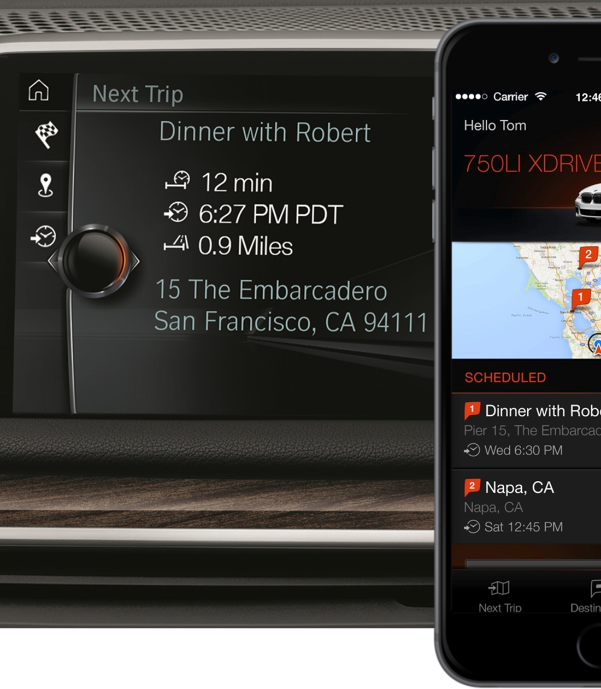

Customer need
Create an intelligent, highly personalized world of digital services that integrate the vehicle seamlessly into the life of the customer and are available 24/7, inside or outside of the car Impact
BMW created the Open Mobility Cloud, an intelligent, continuously learning platform based on Azure that melds environment, context and services to address customers’ individual mobility needs
Notes:
BMW created the Open Mobility Cloud, which drives rapid innovation around customer needs using Azure and Azure Services.
The Open Mobility Cloud is an intelligent, continuously-learning platform built to meld context, environment, touchpoints and services in the right mix and at the right time to address customers’ individual mobility needs.
It is open to integrate any device or partner service that adds value to BMW customers and focused on mobility to seamlessly integrate the vehicle into daily digital life.
The platform is based on state-of-the art cloud technology to work in the background on behalf of BMW consumers to deliver contextual, personalized services just as the need arises.
The platform offers far-reaching capabilities for machine learning and data analysis.
The service utilizes many Microsoft services, including HDInsight, Windows SQL, IoT Event Hubs, Machine Learning, Apps Insight and many more.
With these intelligent tools, the more frequently users make use of digital services, the more effectively they can be personalized.
In addition, the Microsoft platform will allow developers to more easily interoperate innovative applications, data and IoT services into the OMC.
Azure, a global cloud platform, allows for a seamless rollout of services worldwide, scaling quickly to reach customers in any region.
SOURCE: https://www.sbdautomotive.com/en/bmw-microsoft-azure-mobility

Slide 35



Customer need
Collect and aggregate data from aircraft engines at an unprecedented scale
Analyze massive datasets and perform data modeling at scale to accurately detect operational anomalies and help customers plan engine maintenance and repairs Impact
Massive cost savings across the lifetime of an aircraft engine
Innovative insights into aircraft management
Notes:
Flight delays are a familiar headache for most people who fly on commercial airlines.
At a personal level, they are disruptive and costly, but for the airlines the impact is exponentially larger.
Minimizing the cost and disruption of maintenance activities is a key focus for these businesses.
Rolls-Royce has over 13,000 engines for commercial aircraft in service around the world, and for the past 20 years, it has offered customers comprehensive engine maintenance services that help keep aircraft available and efficient.
As the rapidly increasing volume of data coming from many different types of aircraft equipment overtakes the airlines' ability to analyze and take insight from it, Rolls-Royce is using the Microsoft Azure platform to fundamentally transform how it uses data to better serve its customers.
SOURCE: https://customers.microsoft.com/en-us/story/rollsroycestory

Slide 36
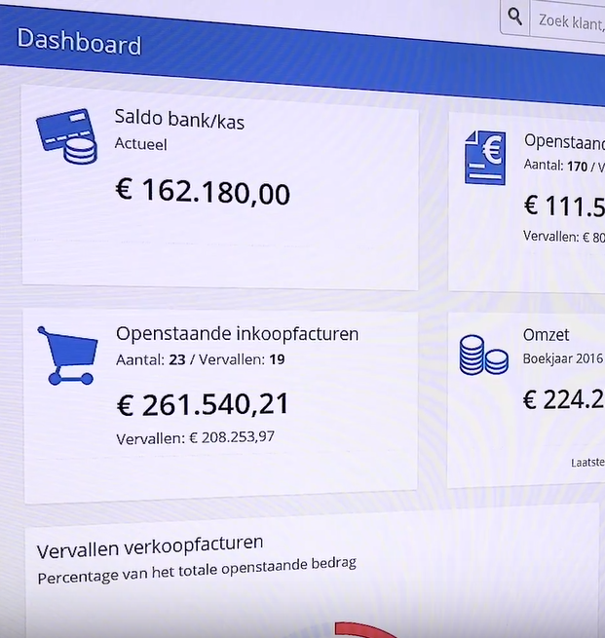

Serving 55K customers with 100 staff
Scenario
Dutch SW provider needed to replace desktop SW delivery model to innovate faster and meet customer needs Solution
Better customer experience through frequent product updates and SaaS model that scales on demand
Automated management reduced overhead and provisions performance with scale
Notes:
https://customers.microsoft.com/en-US/story/accuweather

Slide 37


Customer need
An enhanced digital presence to better connect with customers across multiple digital touch points.
Engaging customers more personally and dynamically across devices Impact
Optimized customer experience with 24/7 availability across devices and apps
Continuous innovation with a DevOps development methodology and cloud application development platform

Slide 38


Customer need
Challenges with variable elevator uptime
Looking to drive greater customer service and competitive differentiation Impact
With dynamic predictive models, goes beyond preventative maintenance with predictive and preemptive maintenance services around the globe
Increased elevator uptime and reduced costs for customers

Slide 39
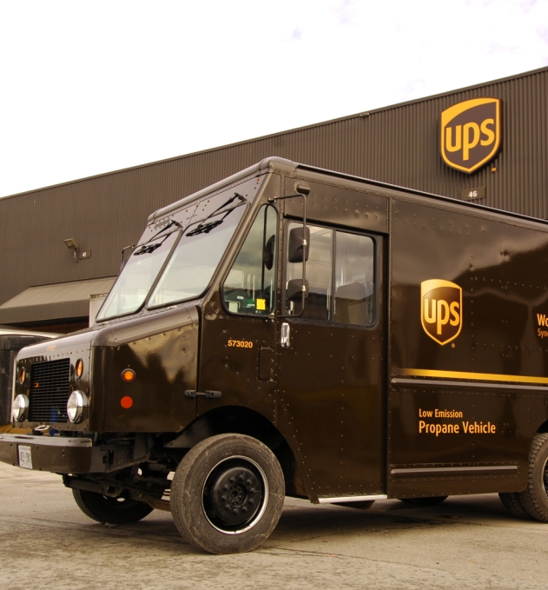

UPS paves the way for better service with artificial intelligence
Scenario
UPS manages more than 192 million customer-tracking requests each day
UPS wanted to create a customer service bot that would engage with customers
Solution
Using Azure, the UPS bot was able to be deployed quickly and efficiently before the busy holiday shipping season
Application insights, blob storage, and encryption for data at rest all powered the UPS bot
Available through Facebook Messenger, Skype and Amazon platforms
Notes:
The UPS chatbot, available through Facebook Messenger, Skype and Amazon platforms, provides users with a convenient and conversational interface that is different from those offered on the UPS website or UPS mobile apps. For example, UPS customers can use simple phrases like “shipping rates” to get prompt voice responses in English. Amazon users can access the UPS chatbot through Amazon’s virtual assistant Alexa, which features voice-recognition capabilities.

